Slide 1
BIOE 498 / BIOE 599: Computational Systems Biology for Medical Applications CSE 599V: Advancing Biomedical Models Lecture 14: Data Management for BioMedical Models
Joseph L. Hellerstein*
Herbert Sauro**
*eScience Institute, Computer Science & Engineering
**BioEngineering

Slide 2

Biological Data

Slide 3
Requirements & Solutions
Requirement
Solution
Find the data
Provenance
Know data semantics
Ease of update
Ease of query
Ease of storage
Validate consistency
Version control
Version control
Documentation
Data management
Data management
Data management
Data tests

Slide 4
Agenda
Case study – Co-evolution of 2 microbes
Data modeling primer and application to case study
SQL with demo
Building SQL repositories in python
In-class exercise

Slide 5
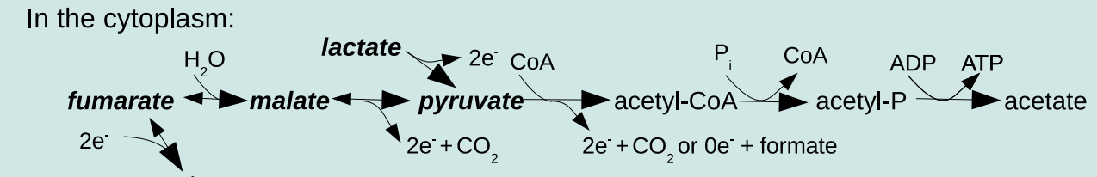
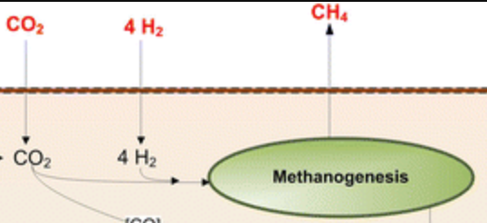
Case Study – Co-evolution of Desulfovibrio vulgaris Hildenborough (DVH) & Methanococcus maripaludis (MMP)
DVH (Bacteria)
MMP (Archaea)
Together

Slide 6
Experiments & Data Collected
Resistance = {R,E,S,A}
DVH
MMP
Line = {H,U} X {R,E,S,A}
not resistant
resistant
not resistant
H
U
H
U
H
U
H
U
Line Replicas
End Point Dilutions
1,000 generations
DVH
Isolate
MMP
Isolate
Mutation Data
Mutation Data
Culture
Growth
Data

Slide 7
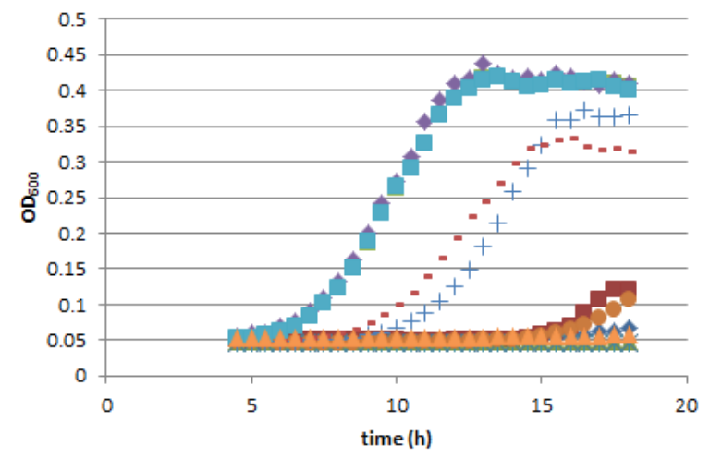
Growth Rate and Yield
Analysis to determine growth rates and yields

Slide 8
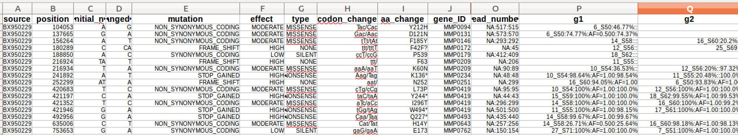
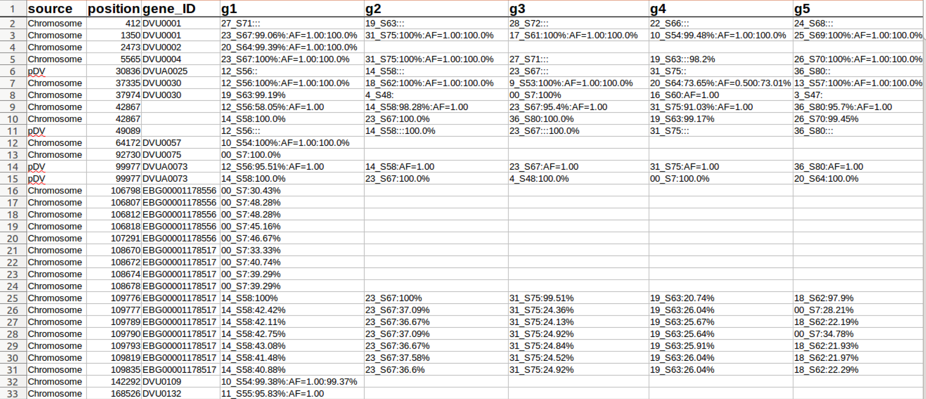
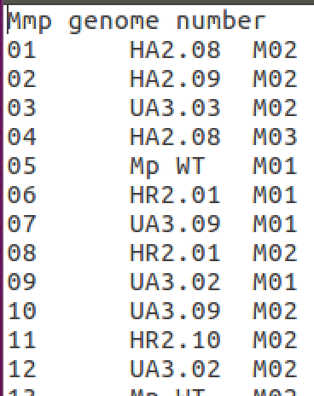
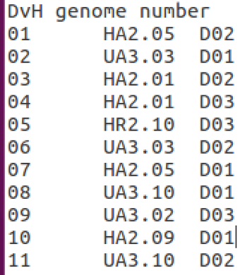
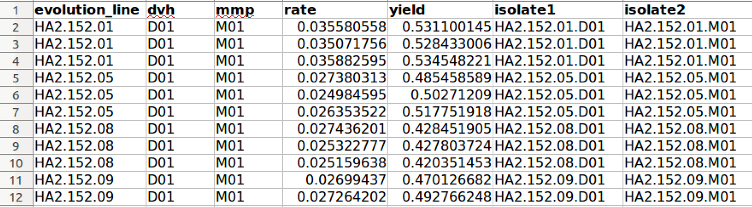
Raw Data
mmp_mutations.xlsx
dvh_mutations.xlsx
names_colonal_isolates_dvh.txt
names_colonal_isolates_mmp.txt
Complex
Error prone
Inflexible
growth_data.xlsx

Slide 9
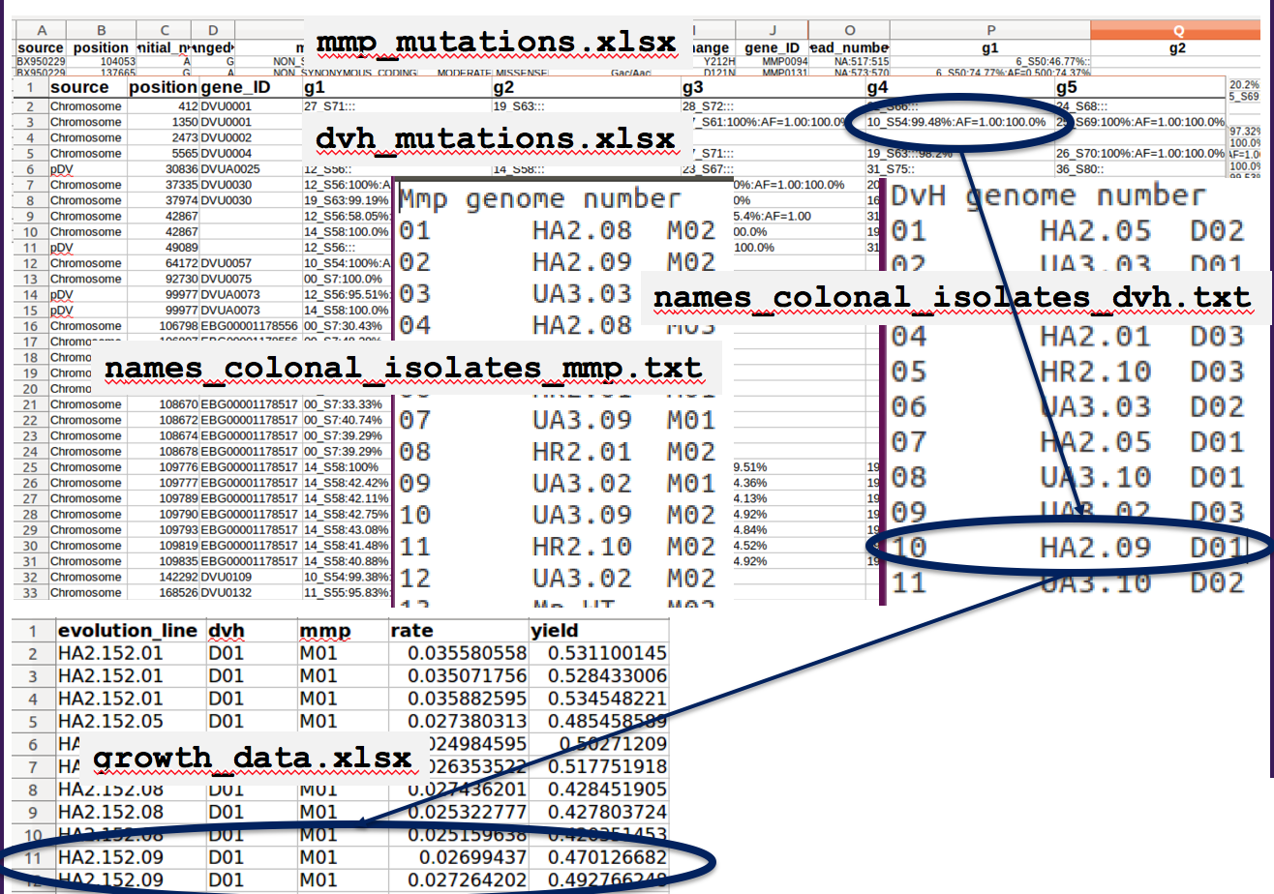
Challenges
Difficult to navigate
Not easily extended?
Augment with gene descriptions?
Incomplete information
Implied transfer times and community

Slide 10
Exposing Hidden Information What is an Isolate?
H
U
H
U
H
U
H
U
Line = {H, U} X {R, E, S, A}
Required information
Line
Transfer time
Endpoint dilution
Clone number
Species
Experiment (isolate or cell)
Extension to communities
All cells in an endpoint dilution at a transfer time
All cells in a line at a transfer time
How do we know when we’ve exposed all necessary information?
When we have a “key” – uniquely identifies the community
DVH
Isolate
MMP
Isolate
Mutation
Mutation
Culture

Slide 11
Naming Isolates (Communities)
H
U
H
U
H
U
H
U
Line = {H, U} X {R, E, S, A}
HA2.152.03.02.D.CI
Line HA2, transfer 152, EPD 03, Clone 02, Species DVH, Clonal Isolate
HA2.152.03.*.*.CI
Line HA2, transfer 152, EPD 03, Clonal Isolates
HA2.152.*.*.*CI
Line HA2, transfer 152, Clonal Isolates
DVH
Isolate
MMP
Isolate
Mutation
Mutation
Culture

Slide 12
What’s Missing in the Isolate Naming? HA2.152.03.02.D.CI, HA2.152.03.*.*.CI, HA2.152.03.*.*.CI
Line replicas are part of the line name?
Using term “Isolate” when it should be a community.

Slide 13
Data Modeling I: Core Concepts
What nouns are required to precisely describe a science question for these data? The CS term for these nouns is Class.
Community (Isolate)
A cell or group of cells.
Key: line, transfer, EPD, clone, species, experiment
Mutation
A change in the genome at a location.
Key: position, new nucleotides
Culture
The environment in which cells are grown and phenotype is measured.
Key: Community, conditions
H
U
H
U
H
U
H
U
Line = {H, U} X {R, E, S, A}
DVH
Isolate
MMP
Isolate
Mutation
Mutation
Culture

Slide 14
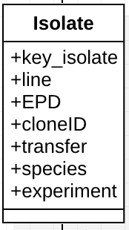
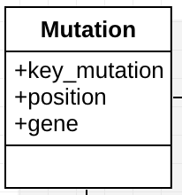
Data Modeling II: Attributes
What qualifiers (descriptors) are needed to precisely identify an instance of a noun (class)?

Slide 15
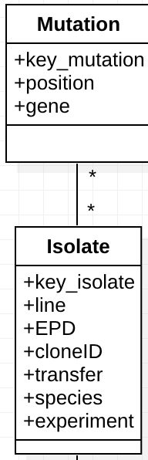
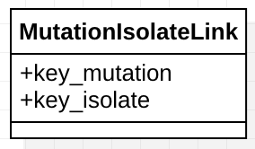
Data Modeling IIIa: Relationships
How do classes (nouns) relate to one another so that information can be “correlated” between classes?
Representing relationships between different classes often requires a new class that specifies associations between keys.

Slide 16
Data Modeling IIIb: Relationships

Slide 17
Data Modeling IIIc: Relationships
GeneDescription provides details about the gene.

Slide 18
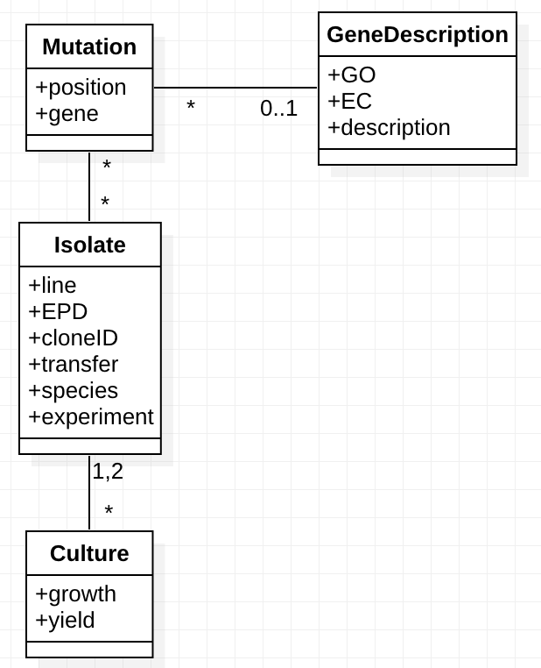
Navigations for a Science Question
H
U
H
U
H
U
H
U
Line = {H, U} X {R, E, S, A}
DVH
Isolate
MMP
Isolate
Mutation
Mutation
Culture
What combinations of mutations in Dvh, Mmp result in larger growth rates and/or yields?
Culture has growth_rate, yield
Mutation has position, gene (if any)
Linking Culture with Mutation requires doing “joins” with Isolate

Slide 19
Normalized vs. Unnormalized Tables
Normalized tables have no redundant data, but must navigate with joins.
Unnormalized tables
Simpler to query
But must use “distinct” to manage redundant data
Must update redundant data

Slide 20
Space vs. Query Simplicity

Slide 21
Use of SQL DB

Slide 22
SQL and Python
Pandas dataframes
Reading CSV
Reading SQL
Writing SQLDB
Column manipulation
Sqllite3 command line and queries

Slide 23
In Class Exercise
In a study of E. coli, CRISPR is used to modify several genes indicated in chemotaxis in different combinations with visual reporters of cell genotype. Movies are taken using live cell imaging to quantify cells movement across gradients of different magnitudes for different sugars. The movies are post-processed to produce tabular data.
What are the core concepts (“classes”) for describing science questions for these data?
What are the attributes for the classes?
How would you structure the data to answer the question “Which mutations cause the largest increase/smallest increase in movement for different sugars?”
Consider a structure of the data where there is a table of mutation data by cell with 2 columns “mutation ID and cell ID” and a table of movement data with 2 columns ”movement type” and “cell ID”.
Create two dataframes with synthetic data for these columns
Create a sqlite DB with tables corresponding to these dataframes
Do a query on the table that yields the join of the tables

Slide 24
BACKUP

Slide 25
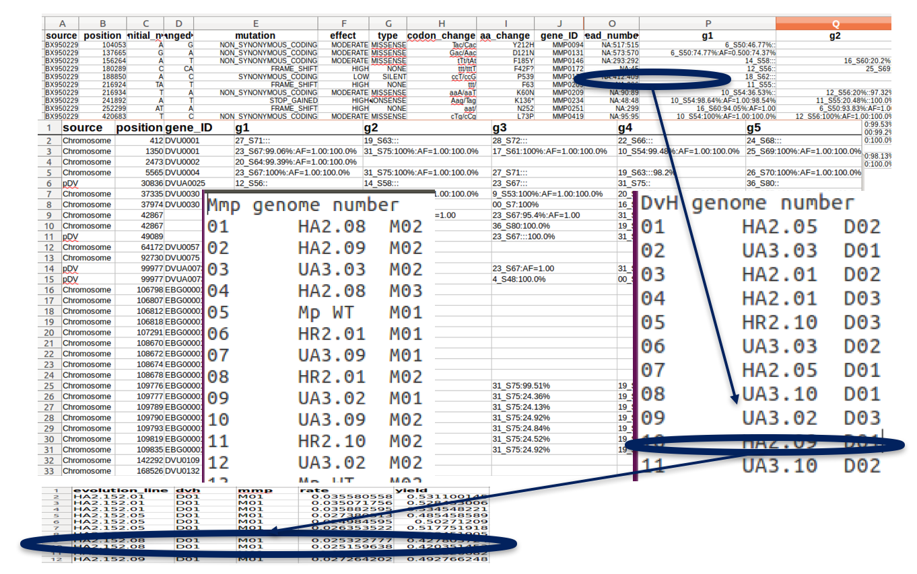
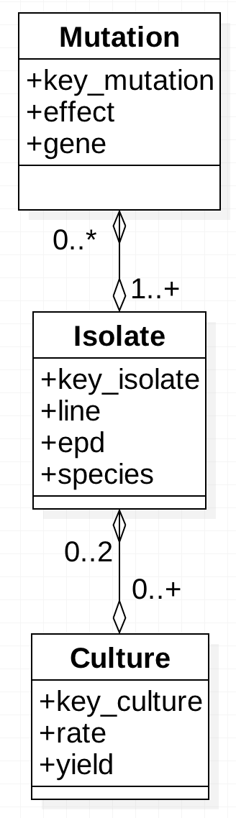
Engineering Data Navigations
“View” computes a single table that integrates the data.
+ changed_nt
Mutation
Isolate
Culture
Challenges
Low coverage isolates -> no mutations
Hold-out isolates -> no cultures
Not lose mutations, isolates, cultures
Not create phantom mutations, isolates, cultures
Notes:
Principles
Mutation – separate collection of data; no gene because can be computed from the key.
Show mutation and its attributes
Show connections with isolates and interrelationships
Show culture
Show database principles
Show resulting view
Line, epd, species can be computed

